Slide 1
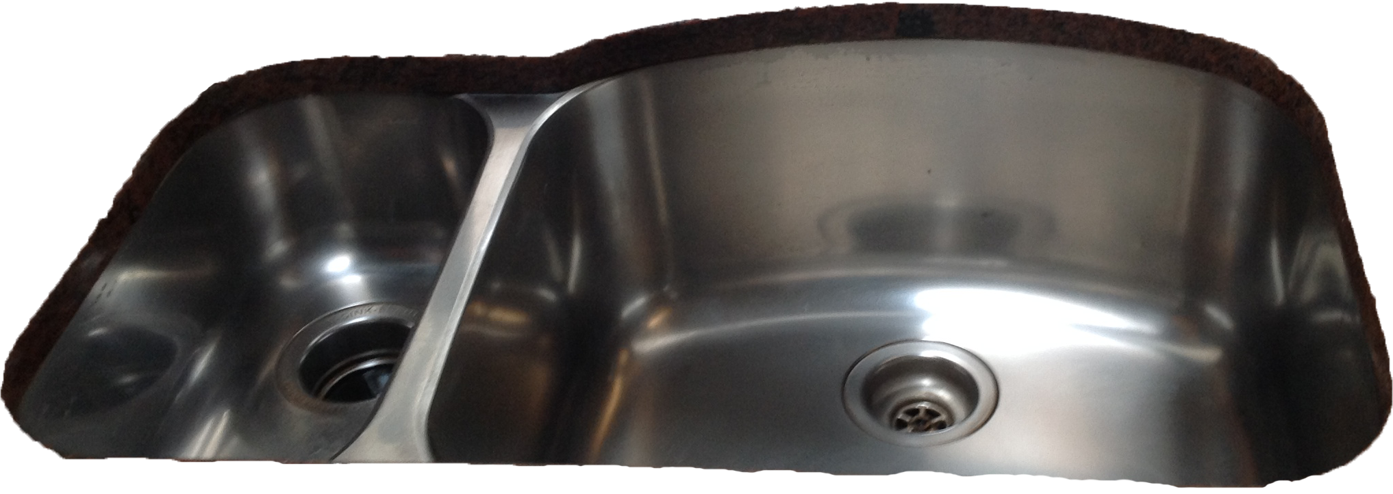
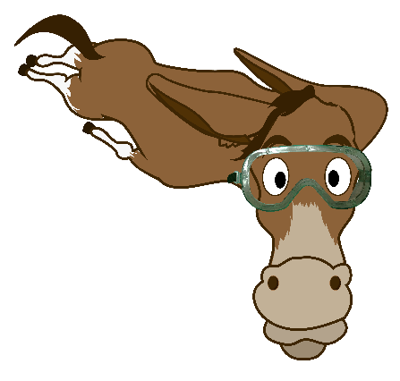
Summing up memory
Barbara Oakley, PhD

Slide 2
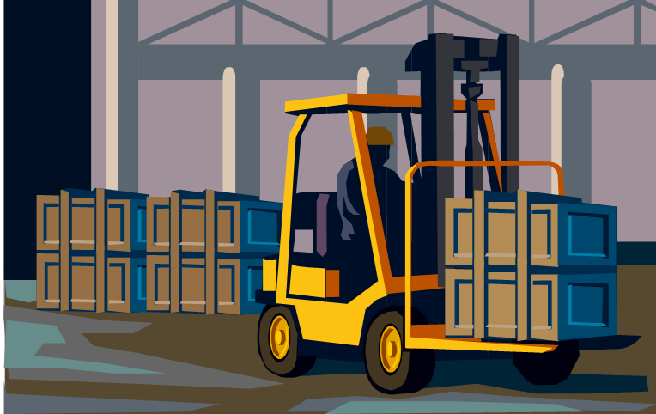
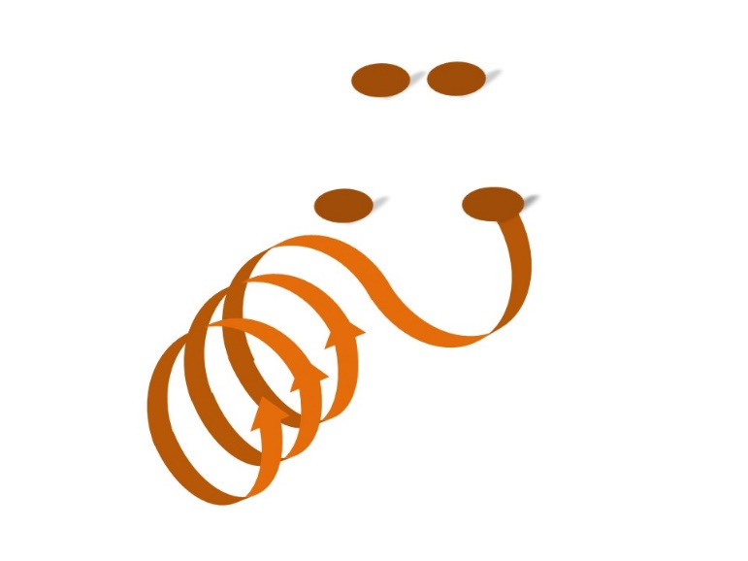

Long term memory
Working memory

Slide 3
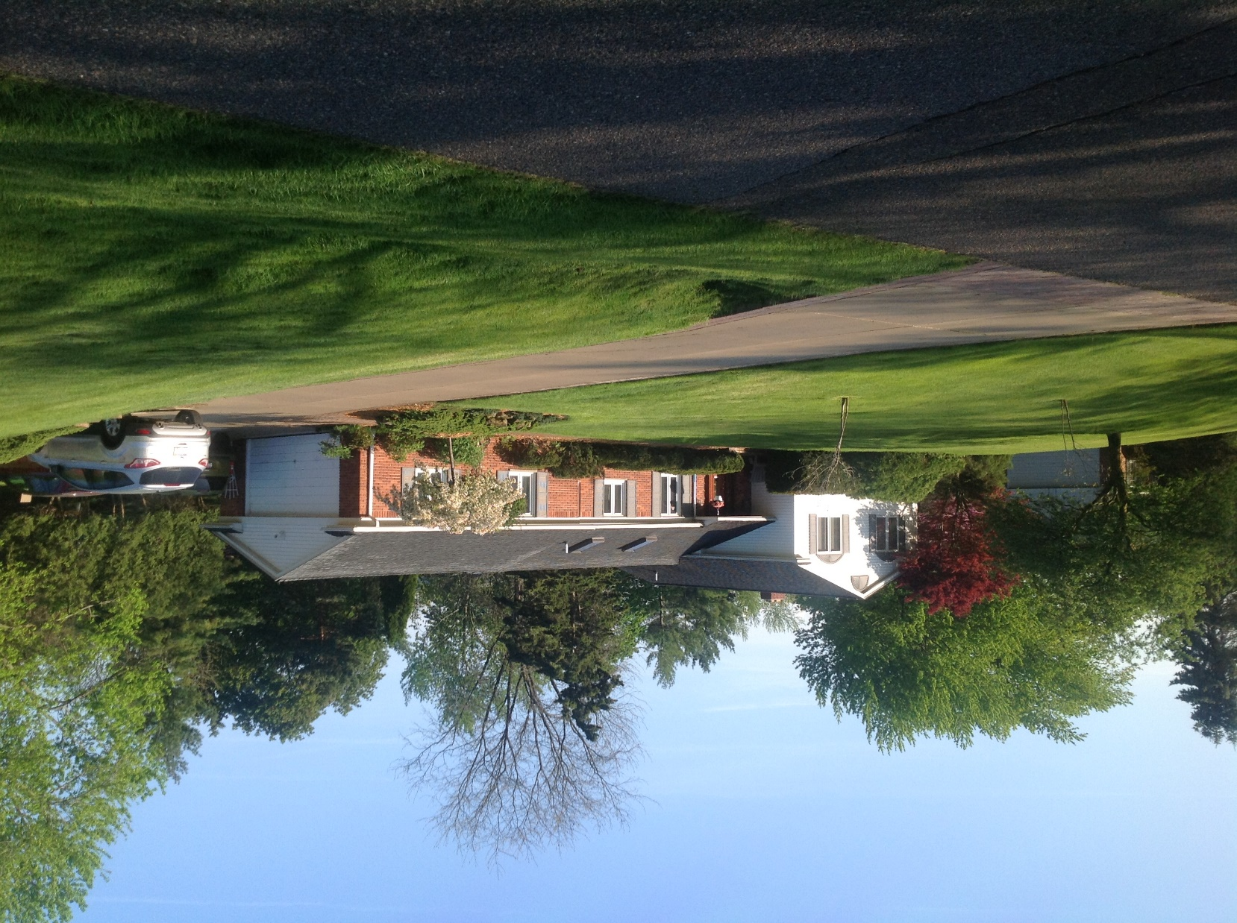
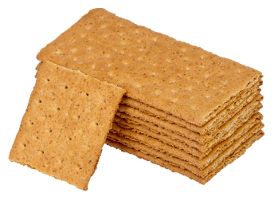
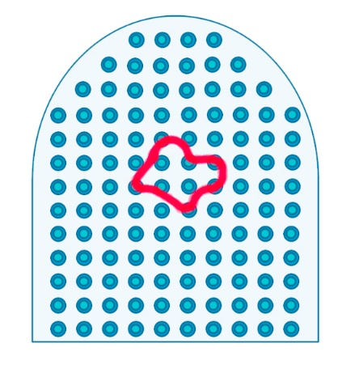

Slide 4
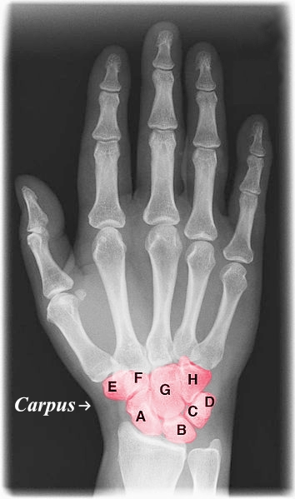
1965
11.0
Old People From Texas
Eat Spiders

Slide 5
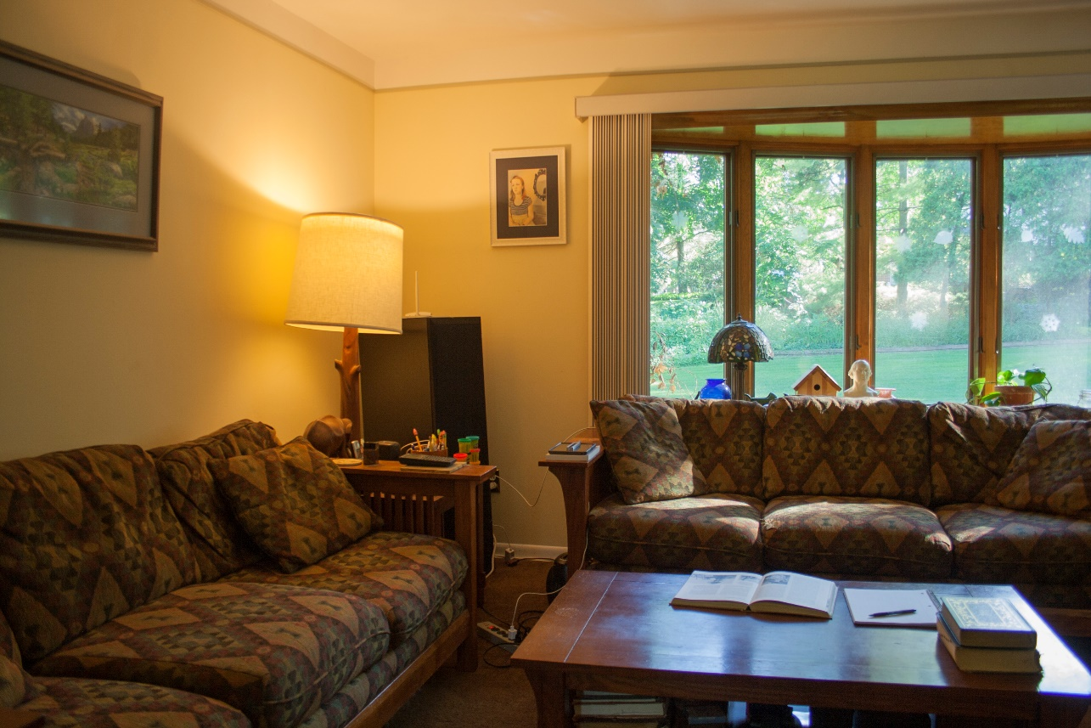
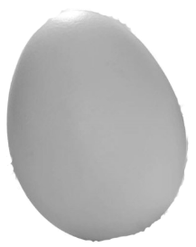
Memory palace technique

Slide 6
Image Credits
Graham cracker stack, by Evan Amos, http://en.wikipedia.org/wiki/Graham_cracker#mediaviewer/File:Graham-Cracker-Stack.jpg
Xray hand with color, by Dr. Jochen Lengerke, http://en.wikipedia.org/wiki/Carpus#mediaviewer/File:Xray_hand_with_color.jpg
Memory ribbon and patterns, © Barbara Oakley, 2014
“Visual” Moussa, MN, MR Steen, PJ Laurienti, and S Hayasaka. "Consistency of Network Modules in Resting-State Fmri Connectome Data." PLoS ONE 7, no. 8 (2012): e44428.
Oakley house, ©Philip Oakley, 2014.
Neural pinball, ©Barbara Oakley, 2014.
Living room, ©Rachel Oakley, 2014.
Kitchen sink, ©Philip Oakley, 2014.
Clip art courtesy Microsoft Corporation

